Slide 1
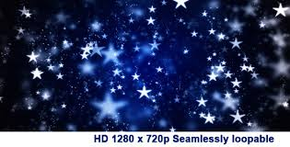
Geography-chapter 2
The earth and the solar system
All objects that one can see in the sky are called HEAVENLY or CELESTIAL BODIES.
These include:
1. The stars

Slide 2
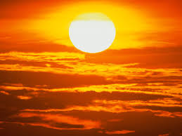
Sun is an example of a Star
It is :
Largest member of the Solar system.
Main source of heat and light.
Its gravitational pull keeps all the members of Solar System together.
The shinning part that we see from the Earth is called the Photosphere.

Slide 3
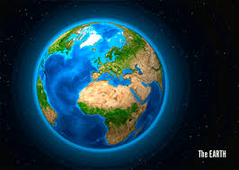
2. The Planets
Earth is an example of a planet.
Earth
A unique Planet:-
a). Favorable temperature,
b). Favorable environmental conditions,
c). Not too near nor too far away from the Sun,
Presence of adequate water and Atmosphere for Life to exist.
Only planet not named after a mythological goddess.

Slide 4
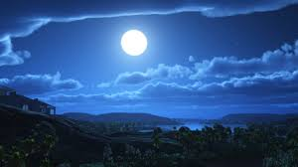
3. The Satellites
Moon is an example of a satellite.
Moon
Closest to the Earth.
Has no light of its own.
Reflects the light of the Sun.
Has no atmosphere and moisture so no life can exist here.
Time of rotation of a moon is equal to that of revolution.
No atmosphere—So no Air---So no sound.

Slide 5
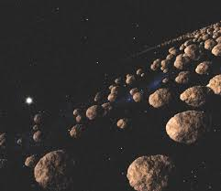
Asteroids
Also called Planetoids or Minor Planets.
Asteroids
Also called Planetoids or Minor Planets.
Each follows its own orbit around the Sun.
Main belt of Asteroids lies between the orbits of Mars and Jupiter.
Believed that they are broken pieces of some planet which must have exploded after birth.

Slide 6
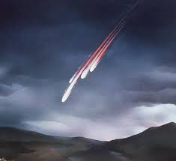
Meteors
Also called Shooting Stars
Meteors
Are small pieces of rocks revolving around the Sun.
Their presence is known only when they enter the Earth’s atmosphere.
They generally burn up on entering.
Are called Meteorites when they enter the surface of the Earth.

Slide 7
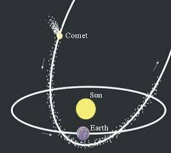
Comets
About 200 crore of them orbiting the Sun.
Are huge lumps of Snow and Rocky Dust.
When they near the Sun they glow and develop a tail.
Most famous- Halleys comet.

Slide 8
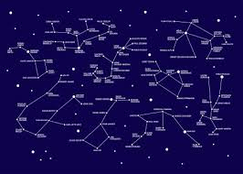
The Constellation
Are groups of bright stars in the sky. Ancient people gave them the figures of animals, people and mythical beasts.
Used as guides for planting, harvesting even slaughtering animals.
Most recognizable Saptarishi- a constellation of seven stars.
Helped people to know the direction –North Star.

Slide 9
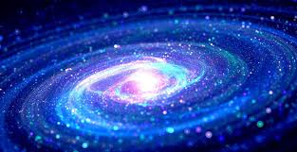
GALAXY
A galaxy is a collection of stars and interstellar material held together by gravity. The solar system is
a part of the Milky Way Galaxy.

Slide 10

SO NOW HAVE YOU UNDERSTOOD, ENOUGH TO WRITE A LITTLE!!!!!!!!!!!!!!!!!!!!
LET’S GET GOING……

